Slide 1
Introduction to Telecommunication systems
T.Njoroge
Computer Science Department
karatina University

Slide 2
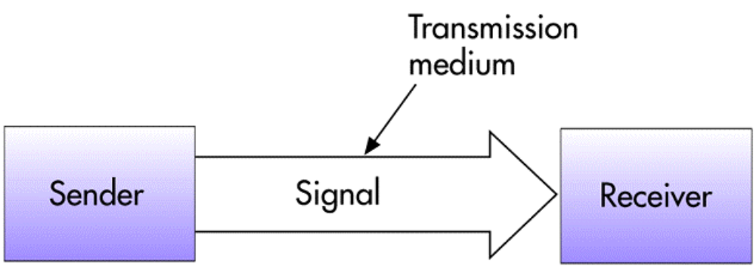
Communications
Communications
  The message (data and information) is communicated via the signal. The transmission medium “carries” the signal.

Slide 3

Telecommunications
Telecommunications
  The electronic transmission of signals for communications, including such means as:
    Telephone
    Radio
    Television
Telecommunication medium
Anything that carries an electronic signal and interfaces between a sending device and a receiving device.

Slide 4
Data Communications
Data communications
  A specialized subset of telecommunications that refers to the electronic collection, processing, and distribution of data -- typically between computer system hardware devices.

Slide 5
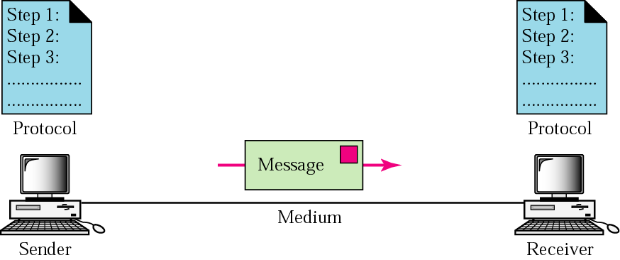
Data Communications

Slide 6
Computer Network
Computer Network
  The communications media, devices, and software needed to connect two or more computer systems and/or devices.
  Used to share hardware, programs, and databases across the organization.
  Fosters teamwork, innovative ideas, and new business strategies.

Slide 7
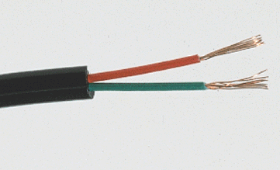
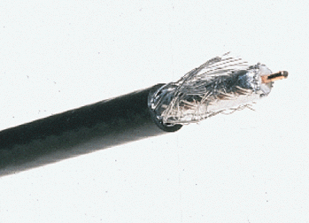
Types of Telecommunication Media
Twisted Pair Wire Cable
  Insulated pairs of wires historically used in telephone service and to connect computer devices.
Coaxial Cable
  Consists of an inner conductor wire surrounded by insulation, called the dielectric. The dielectric is surrounded by a conductive shield, which is surrounded by a non-conductive jacket. Coaxial cable has better data transmission rate than twisted pair.

Slide 8
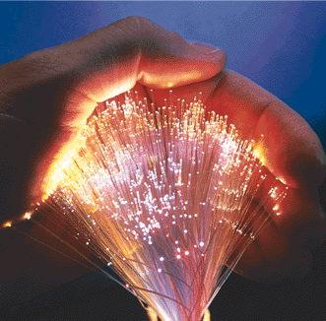
Types of Telecommunication Media
Fiber-optic Cable
  Many extremely thin strands of glass or plastic bound together in a sheathing which transmits signals with light beams. Can be used for voice, data, and video.

Slide 9

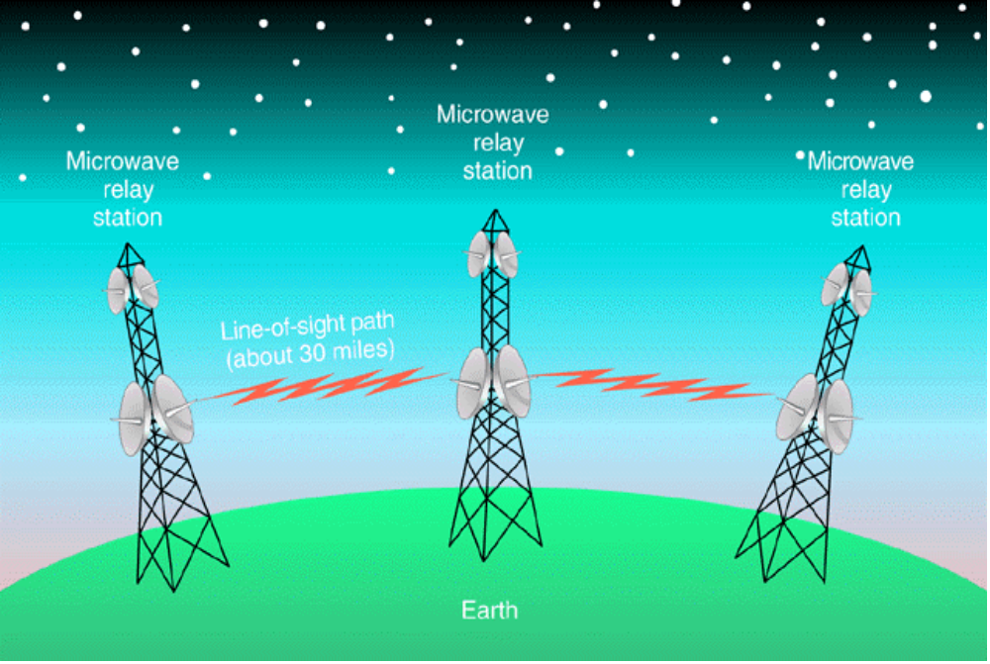

Types of Telecommunication Media
Microwave Communications
Line-of-sight devices which must be placed in relatively high locations.
Microwave Usage
Information is converted to a microwave signal, sent through the air to a receiver, and recovered.

Slide 10
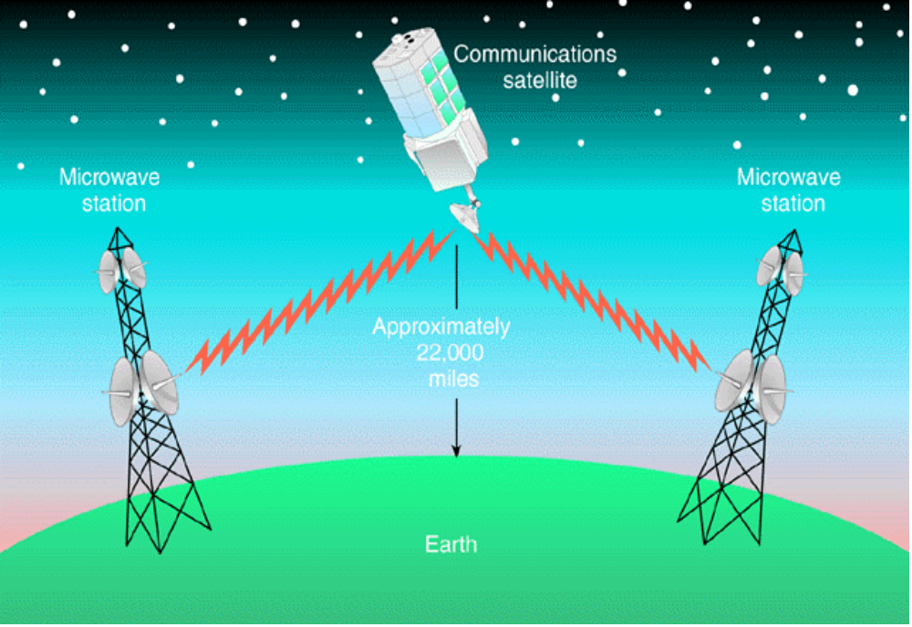

Types of Telecommunication Media
Satellite Transmission
Communications satellites are relay stations that receive signals from one earth station and rebroadcast them to another.

Slide 11
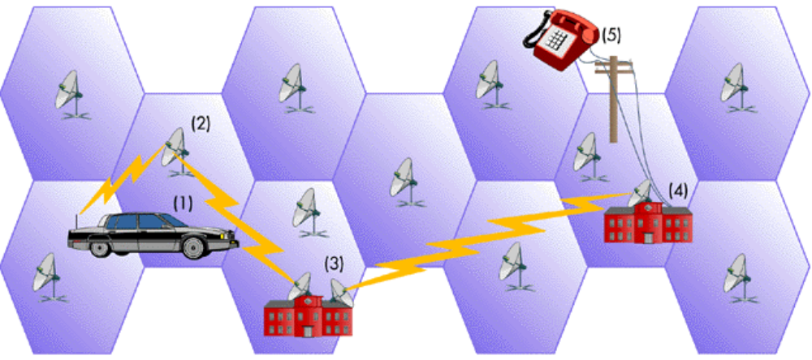

Types of Telecommunication Media
Cellular Transmission
Signals from cells are transmitted to a receiver and integrated into the regular network.

Slide 12
Types of Telecommunication Media
Infrared Transmission
  Involves sending signals through the air via light waves.
    Requires line-of-sight and short distances (a few hundred yards)
    Used to connect various computing devices such as handheld computers

Slide 13
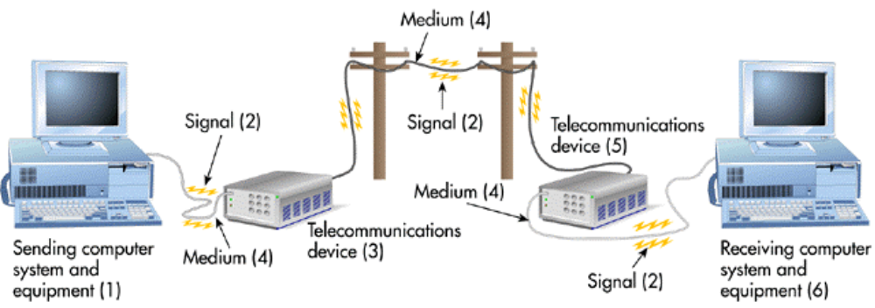

Telecommunications System
Telecommunication Devices
Relay signals between computer systems and transmission media.

Slide 14
Telecommunication Devices
Analog Signal
  E.G. Electricity current
Digital Signal
  A signal represented by bits
Modems
  Devices that translate data from digital to analog and analog to digital
Terminology

Slide 15
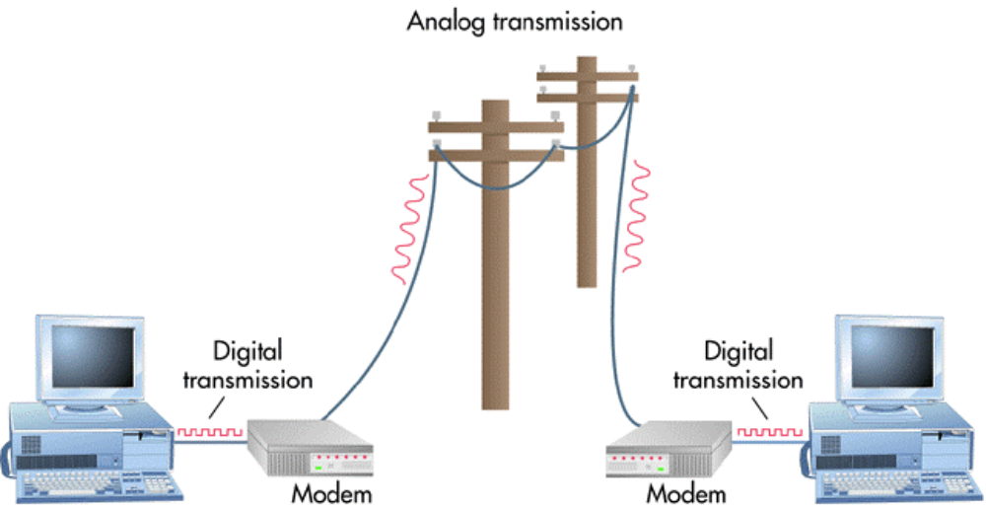

Device: Modem
Modem
Modulates a digital signal into an analog signal for transmission via analog medium, then demodulates the signal into digital for receiving.

Slide 16
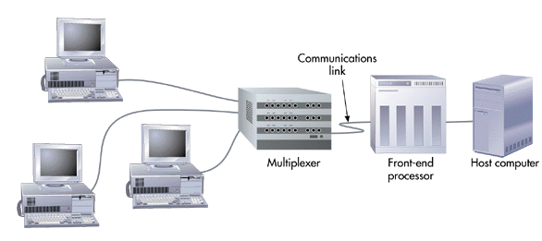

Device: Multiplexer
Figure 6.11
Multiplexer
Allows several telecommunications signals to be transmitted over a single communications medium at the same time.

Slide 17
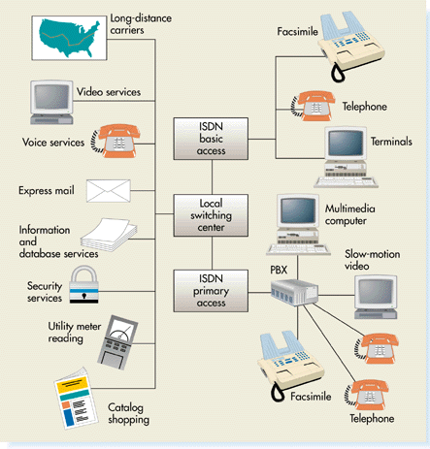

Media: Integrated Services Digital Network (ISDN)
ISDN
Technology that uses existing common-carrier lines to simultaneously transmit voice, video, and image data in digital form.

Slide 18
Distributed Processing
Centralized Processing
  Data processing that occurs in a single location or facility.
Distributed Processing
  Data processing that occurs when computers are placed at remote locations but are connected to each other via telecommunications devices.
  The computers are connected as a computer network.

Slide 19
Network Types
By Topology
  A model that describes how computers are connected
  A logical model that describes how networks are structured or configured
24

Slide 20
Network Types
Structured
  Ring
  Bus
  Star
  Hierarchical
  Hybrid
Unstructured
  Mobile Adhoc Network (MANET)

Slide 21
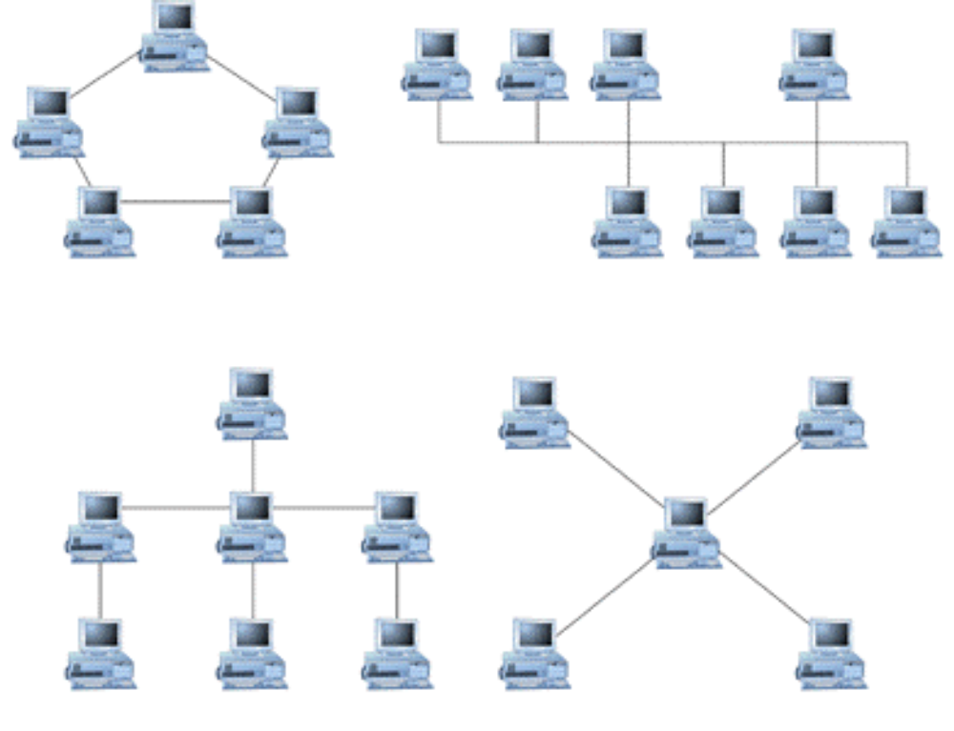
Network Topologies
Ring
Bus
Hierarchical
Star
25

Slide 22
Network Topologies
For local area networks, not for the Internet
Ring
  A typology that contains computers and computer devices placed in a ring.
Bus
  Computers and computer devices are on a single line. Each device can communicate directly to all devices on the bus.
Star
  All computers are connected via a central hub.

Slide 23
Network Topologies
Hierarchical
  Uses treelike structures with messages passed along the branches of the hierarchy
Hybrid
  A mix of different kinds of structured topologies. It is what exactly the Internet looks like.
Mobile Adhoc Network
  It is unstructured network topology
  Structure is changing dynamically. EG. Network of mobile phone.

Slide 24
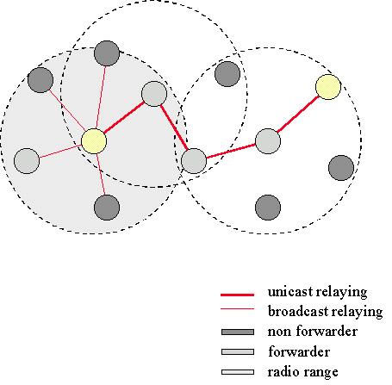
Network Topologies
Mobile Adhoc Network
  Network does not have specify topology
  Each computer in the network is moving around without locating in a fixed location
  Sending and receiving messages are difficulty problems

Slide 25
Network Types by Size
Local Area Network (LAN)
  Connects computer systems and devices in the same geographic area (can be Ring, Bus, Hierarchical, Star, Hybrid)
Wide Area Network (WAN)
  Ties together large geographic regions using microwave and satellite transmission or telephone lines.
International Network
  Links systems between countries.
27

Slide 26
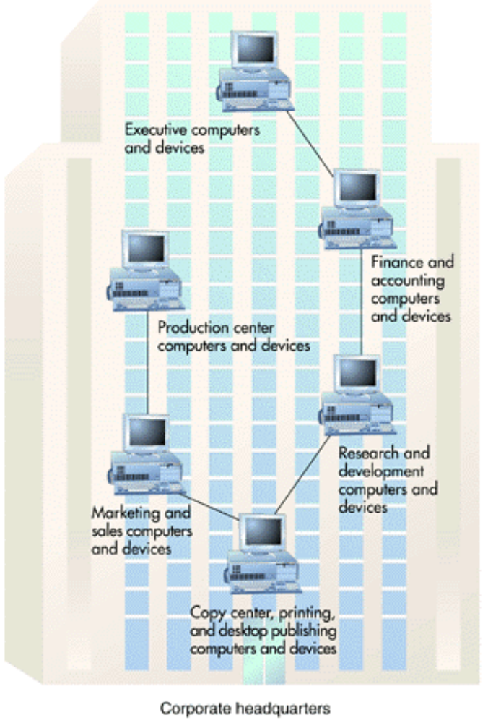
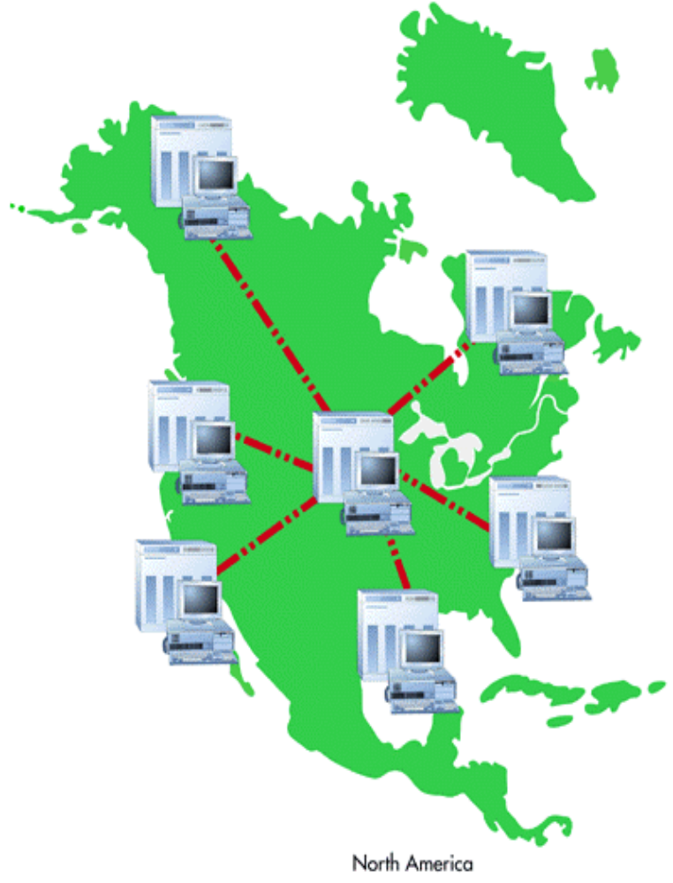
LAN & WAN
A Typical LAN in a BUS Topology
A Wide Area Network

Slide 27
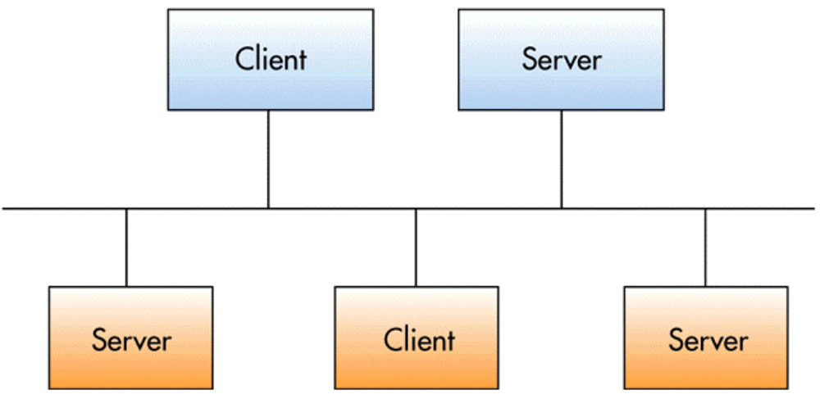

Client/Server Connection
Applications and databases reside on specialized host computers.
Servers do most or all of the processing and transmit the results to the client.
31

Slide 28
Advantages & Disadvantages of Client/Server
Advantages
  Reduced cost potential
  Improved Performance
  Increased Security
Disadvantages
  Increased cost potential
  Loss of control
  Complex multi-vendor environment
32

Slide 29
Communications Software
Communications Software
  Provides error checking, message formatting, communications logs, data security and privacy, and translation capabilities for networks.
Network Operating System (NOS)
  Systems software that controls the computer systems and devices on a network and allows them to communicate with each other.
Network Management Software
  Enables a manager on a networked desktop to monitor the use of individual computers and shared hardware, scan for viruses, and ensure compliance with software licenses.
33

Slide 30
Protocols
Protocol
  Rules that ensure communications among computers of different types and from different manufacturers.
  Rules that determine the form of signal being transmitted, encoded, error detection and correction, etc.
34

Slide 31
Protocols
OSI 7-Layers Model
  Serves as a standard model for network architectures and is endorsed by the International Standards Committee. Communication functions are represented in seven layers to promote the development of modular networks. Designed to permit communication among different computers from different operating systems.
35

Slide 32
Protocols
Transmission Control Protocol/Internet Protocol (TCP/IP)
  Standard originally developed by the U.S. government to link defense research agencies; it is the primary communication protocol of the Internet.
Systems Network Architecture (SNA)
  IBM communication protocol for LAN.
Ethernet
  Protocol standard developed for LANs using a bus topology.
  X.400 and X.500
  An international standard for message handling and network directories.
36

Slide 33
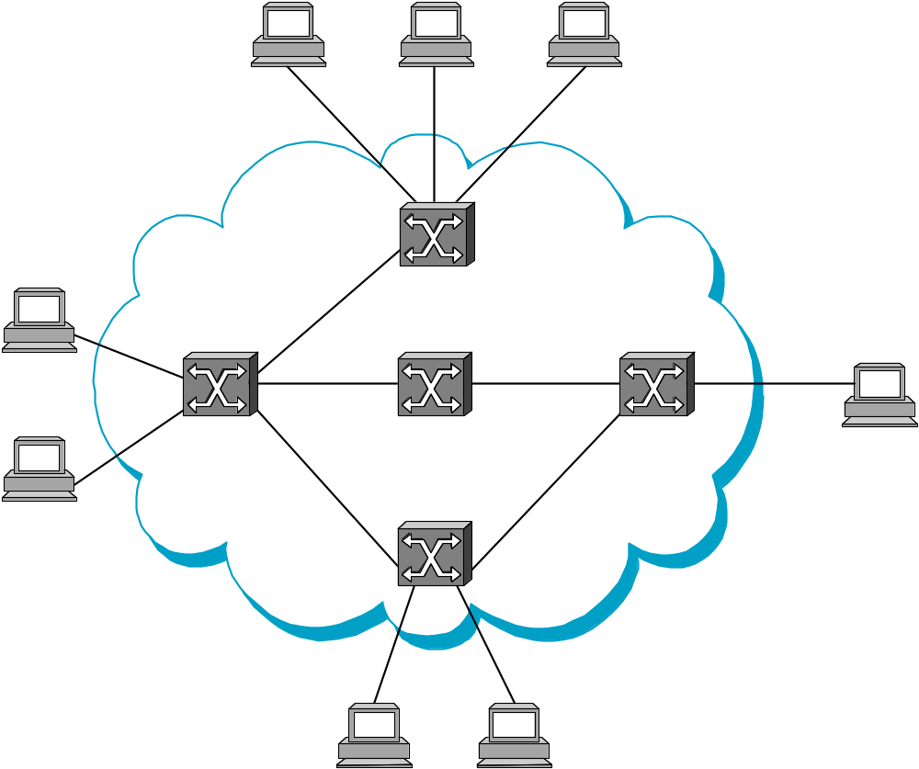
Protocol (Idea)

Slide 34
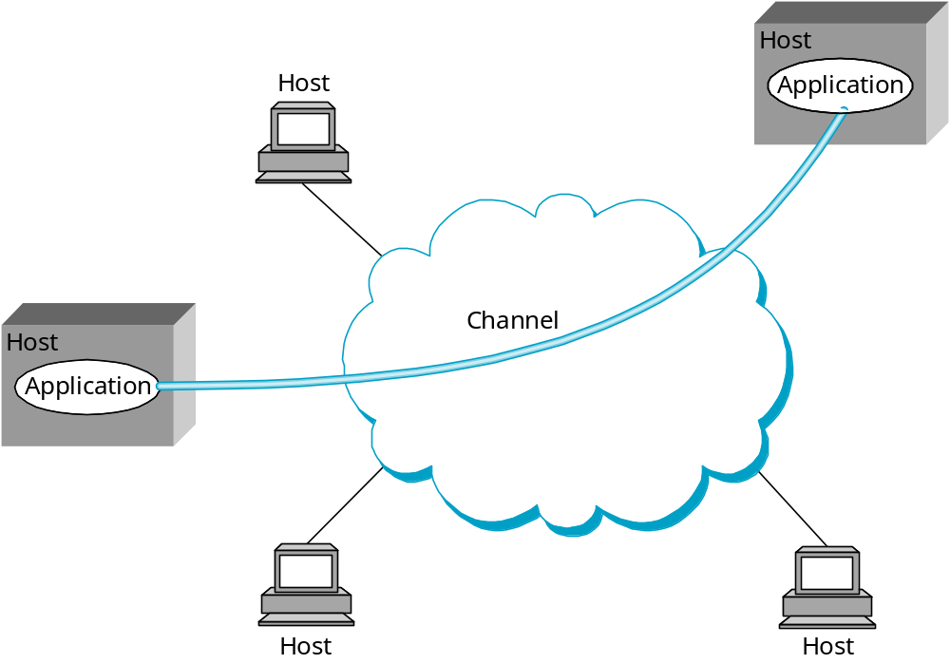
Protocol (Idea)

Slide 35
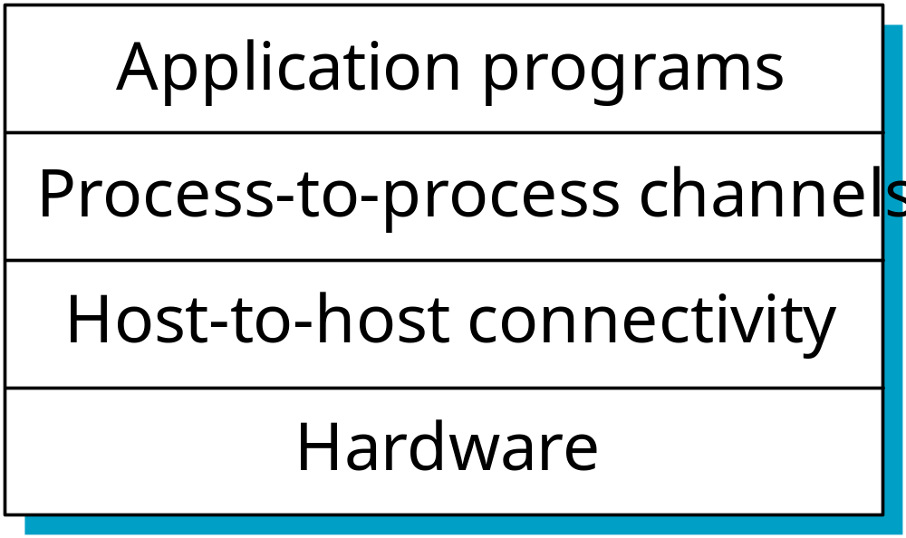
Protocol (Idea)

Slide 36
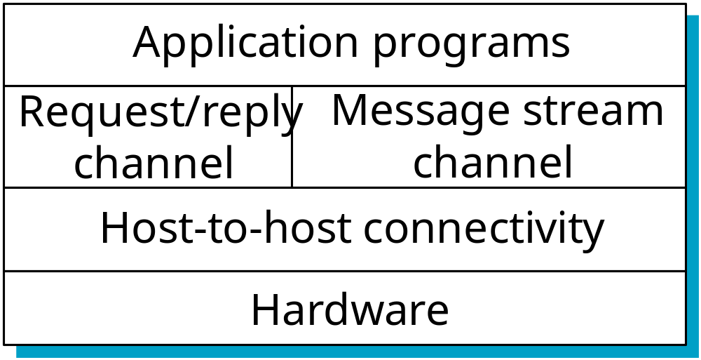
Protocol (Idea)
When and how to start a channel?
When and how to close a channel?
How to protect the channel against invasion?
How to handle multiple applications?

Slide 37
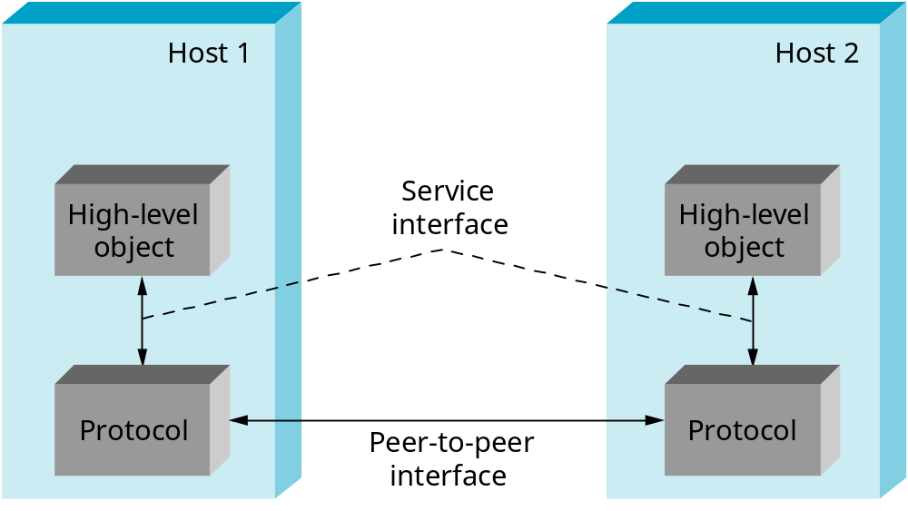
Protocol (Idea)

Slide 38
Protocol (Idea)
Host 1
Host 2
File
Digital
Video
File
Digital
Video
application
library
application
application
library
application
application
application

Slide 39
Protocol (Idea)
Host
Host
Application
Application
Application
Application
program
program
program
program
Data
Data
RRP
RRP
RRP Data
RRP Data
HHP
HHP
HHP RRP Data

Slide 40
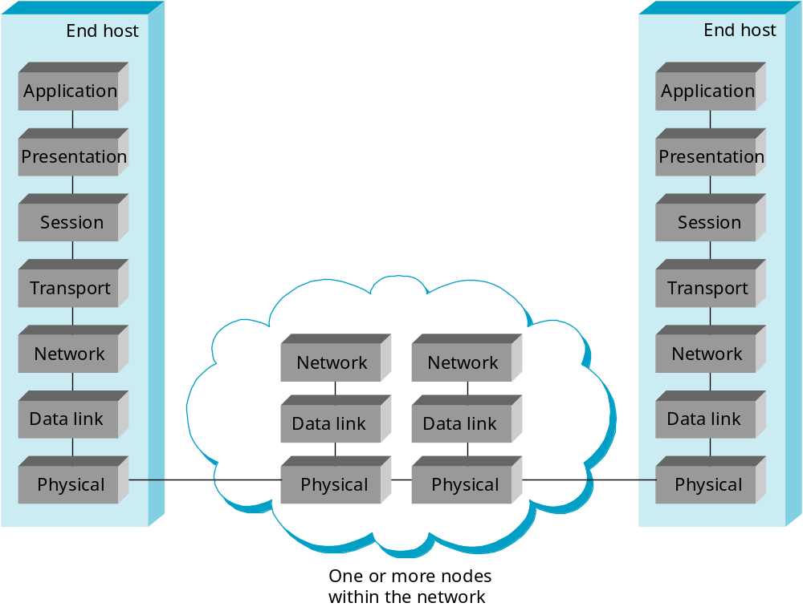
Protocol (OSI 7 Layers Model)

Slide 41
Protocol (TCP/IP)
FTP
HTTP
NV
TFTP
TCP
UDP
IP
NET
NET
■ ■ ■
NET
1
2
n

Slide 42
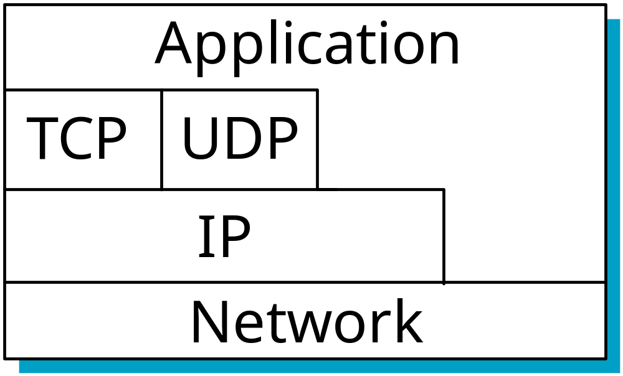
Protocol (TCP/IP)

Slide 43
Applications
Linking Personal Computers to Mainframe Computers
  Download and upload information.
Voice Mail
  Enables users to leave, receive, and store verbal messages for and from other users.
Electronic Mail (e-mail)
  Enables a sender to connect a computer to a network, type messages, and send it to another person on the network.
39

Slide 44
Applications
Electronic Software Distribution
  Involves installing software on a file server for users to share by signing onto the network and requesting that the software be downloaded onto their computers over a network.
Electronic Document Distribution
  Transporting documents -- such as sales reports, policy manuals, and advertising brochures -- over communications lines and networks.
40

Slide 45
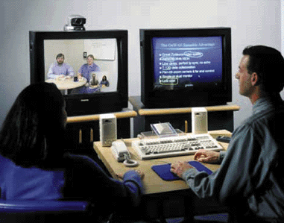
Telecommunications Applications Videoconferencing
41

Slide 46
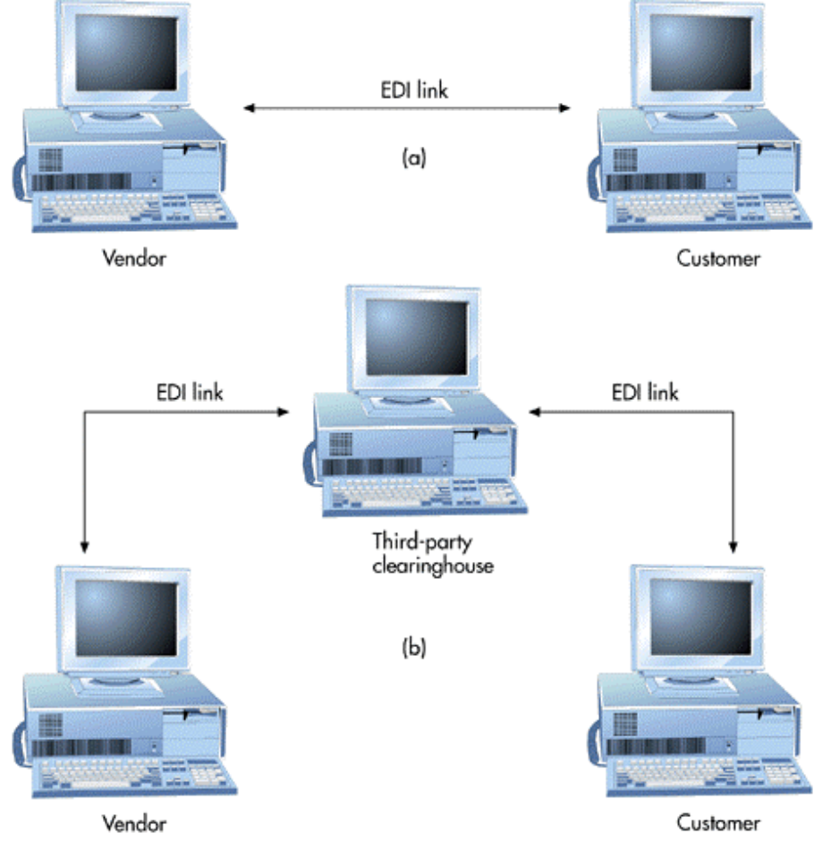
Telecommunications Applications EDI
42

Slide 47
Telecommunications Applications
Public Network Services
  Services that give personal computer users access to vast databases and other services, usually for an initial fee plus usage fees.
Specialized and Regional Information Services
  Specialized electronic bulletin boards and e-mail services targeting particular interests.
Distance Learning
  Use of telecommunications to extend the classroom.
43

Slide 48

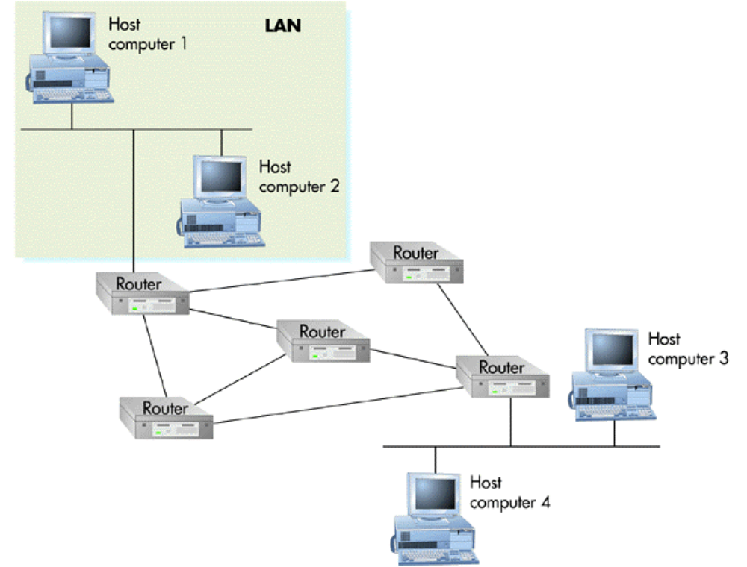

The Internet
Internet Networks
Linked networks that work much the same way -- they pass data around in packets, each of which carries the addresses of its sender and receiver.
The Internet
The Internet transmits data from one computer (called a host) to another.

Slide 49
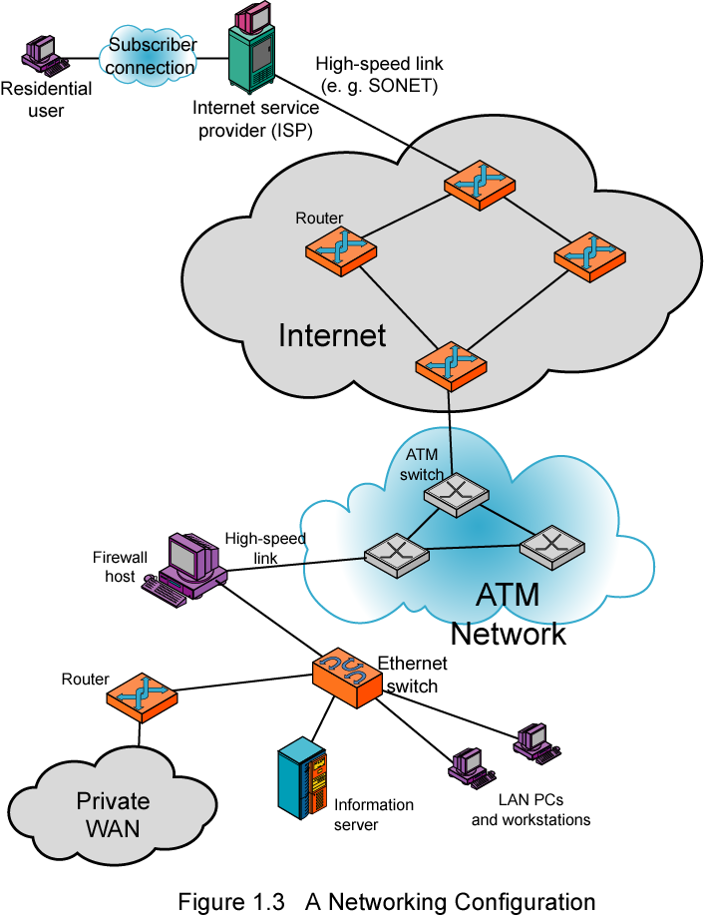
The Internet

Slide 50
How the Internet Works
Protocol
  A protocol that operates at the transport layer and is used in combination with IP by most Internet applications
  It ensures that computers in Internet can understand the message sending among each others.
Backbone
  One of the Internet’s high-speed, long distance communications links.
IP Address/Port
  IP address is the unique identification on a computer that is connecting to the Internet.
  Ports are the input/output locations of a computer where messages should send in or out.
  If an IP address is analogy to a country, then the Port addresses will be analogy to the ports of that country.

Slide 51
Access to the Internet
LAN Servers
  Local servers can provide access to the Internet through normal connections (e.g. Ethernet)
Connection via an On-Line Service
  Communications protocol (SLIP/PPP) software that transmits packets over telephone lines, allowing dial-up access to the Internet. (Modem access)
  Examples are American Online (AOL) and Microsoft Network. These services usually require sign-up procedures. (Leased line)

Slide 52
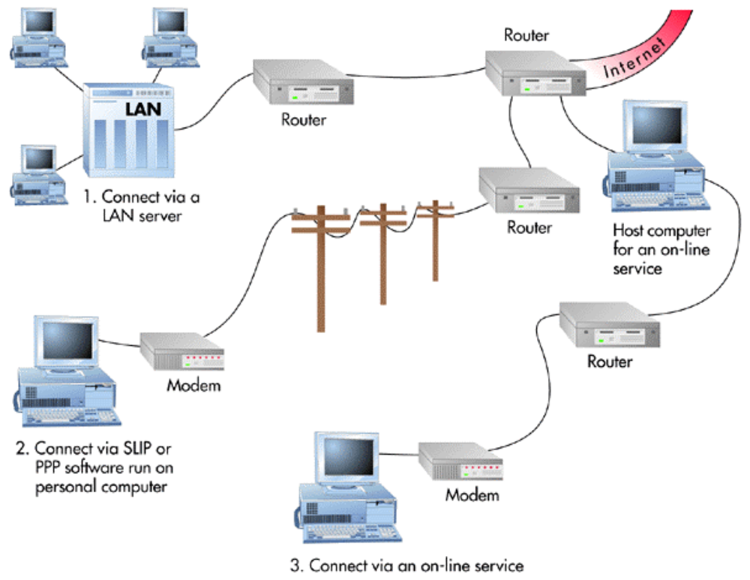
Ways to Access the Internet

Slide 53
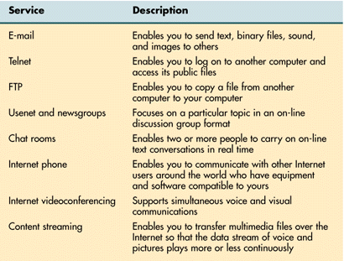
Internet Services

Slide 54
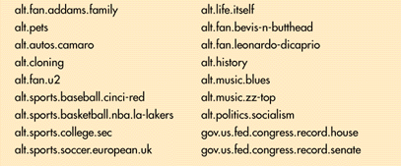
Selected Usenet Groups

Slide 55
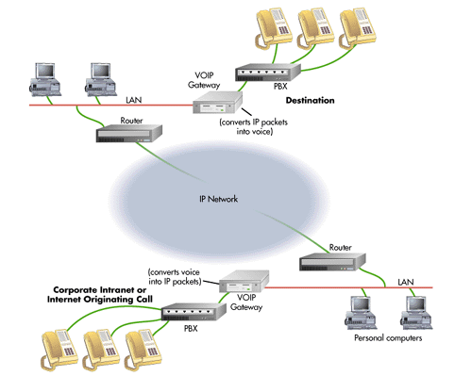

VOIP Service
Voice-Over-IP (VOIP)
Technology that enables network managers to route phone calls and fax transmissions over the same network they use for data.

Slide 56
Internet Entertainment
Content Streaming
  A method for transferring multimedia files over the Internet so that the data stream of voice and pictures plays continuously, without a break, or very few of them. It also enables users to browse large files in real time.
IPTV

Slide 57
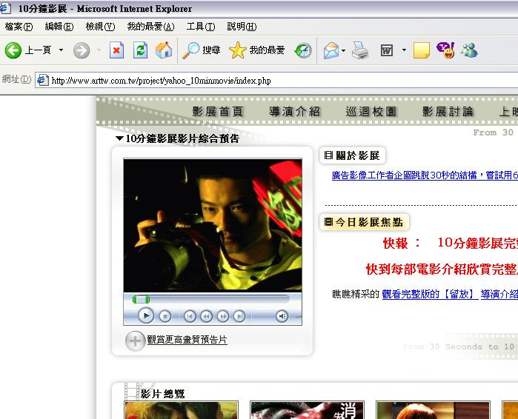
Internet Entertainment

Slide 58
Information Browsing
World Wide Web
  A collection of tens of thousands of independently-owned computers that work together as one in an Internet service.
Web Browser
  Software that creates a unique hypermedia-based menu on your computer screen and provides a graphical interface to the Web.
Web Page
  A screen of information sent to a requesting user and presented through a browser.
Search Engines
  A search tool for the Web (like card catalogs in libraries).

Slide 59
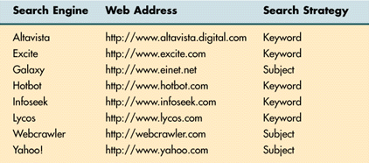
World Wide Web

Slide 60

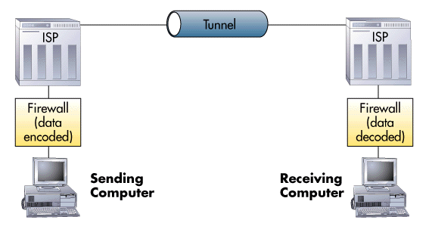

Virtual Private Network (VPN)
Virtual Private Network (VPN)
A secure connection between two points across the Internet.
Tunneling
The process by which VPNs transfer information by encapsulating traffic in IP packets and sending the packets over the Internet.
24

Slide 61
Trends Driving Data Communication
Traffic growth
  Increasing number of Internet users
  Voice & data; local and long distance
Development of new services
  Examples: VoIP, IPTV, Online Games
  In turn drives increased traffic
Advances in technology
  Examples: Fiber optics vs copper cable, 2G vs 3G, wired vs wireless
  Encourage and support increased growth and development

Slide 62
Key Technology Trends
Faster and cheaper computing and communications
Increasingly “intelligent” networks
Growing importance of Internet, intranet and extranet applications
Increasing use of and dependence on mobile technologies, e.g. personal networks

Slide 63
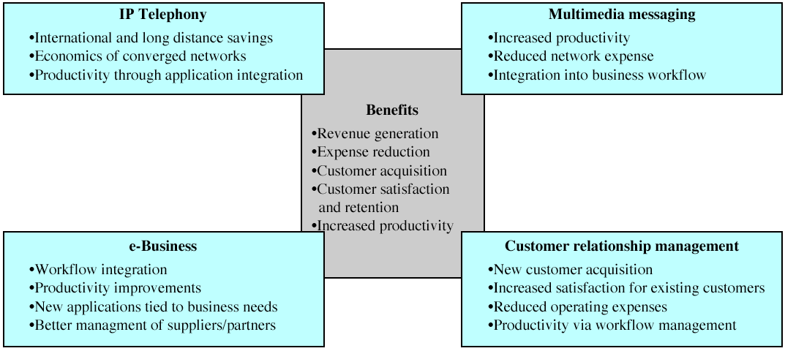
Applications Driving Enterprise Networks

Slide 64
Model of Enterprise Communications
4-layer model of enterprise communications
  Applications
  Services
  Management
  Infrastructure
Applications generated by business needs
Notes:
See figure 1.3 in book for relationship among layers.

Slide 65
Types of Business Information
Text
  ASCII, Extended ASCII, Unicode, ISO
Numbers
Images
Video
Voice

Slide 66
Effectiveness of data communication systems
Performance
  if the systems can deliver data in a timely manner based on the types of data
Reliability
  if the systems can provide non-stop services, measured by the frequency of failure or recovery time of a network after failure
Security
  if the systems can protect the transmitted data from illegal access and/or modification

